Slide 1
Intro to Computer Vision

Slide 2
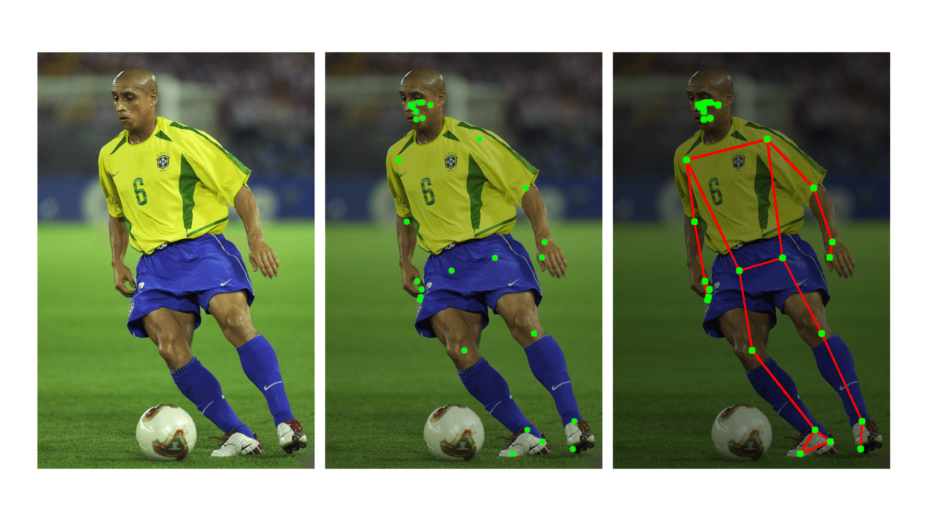
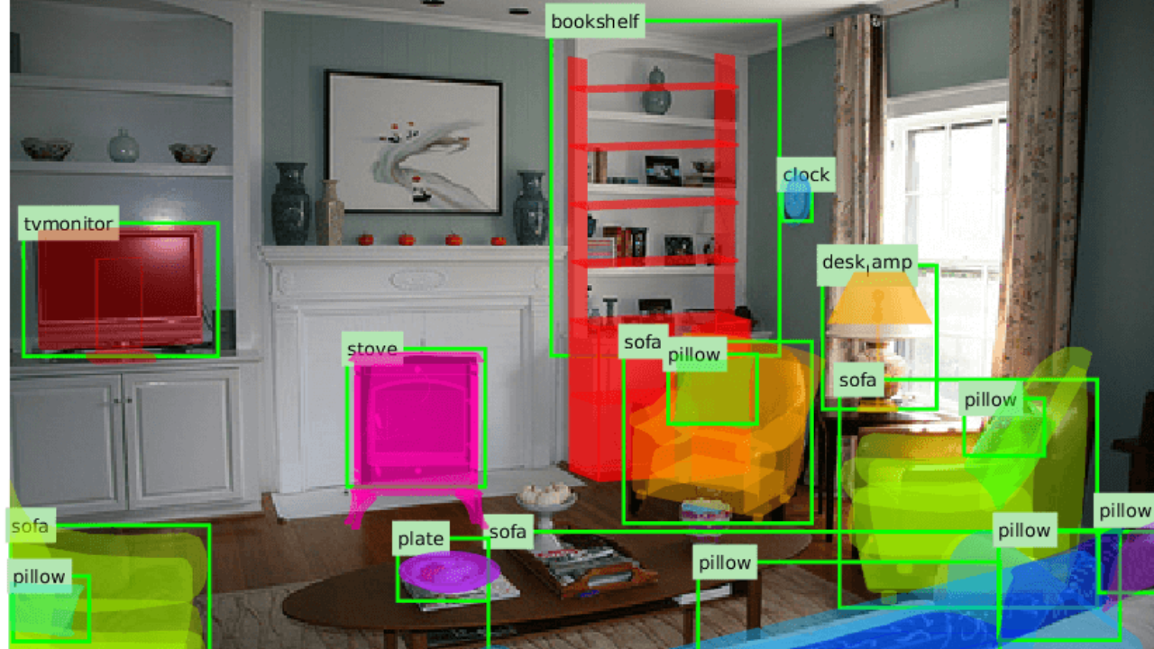
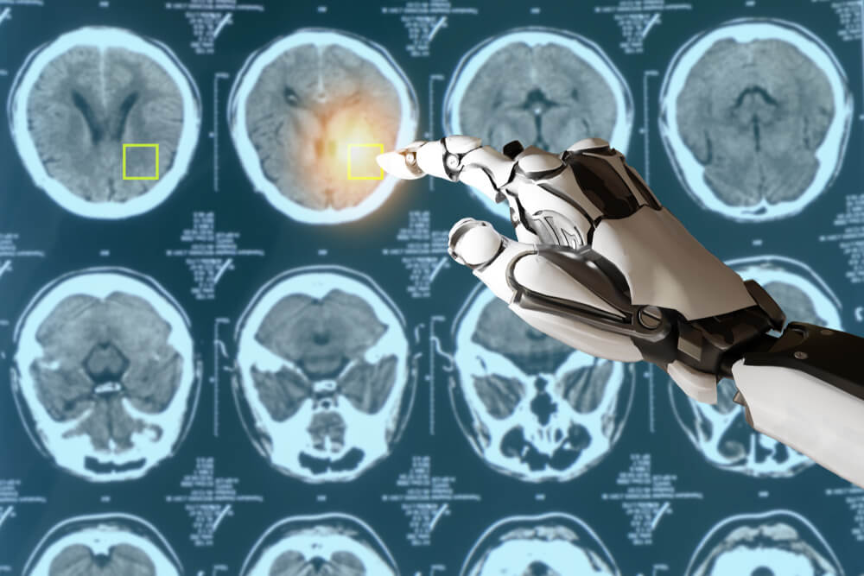
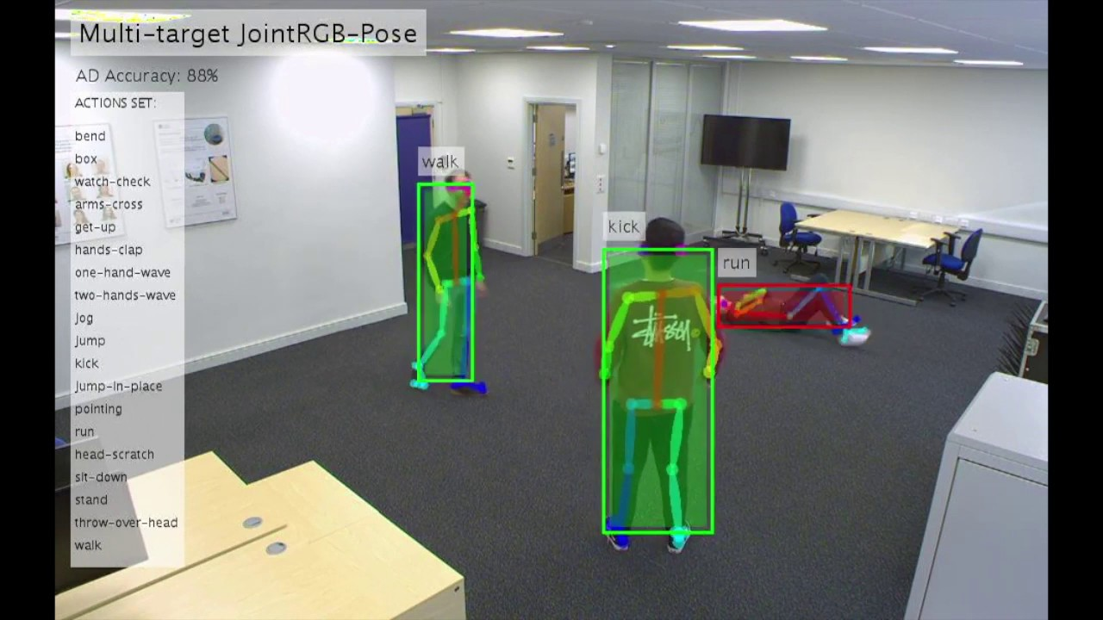
What is Computer Vision?
Broadly, a field of computer science focused on understanding images and videos
Subfields include:
Scene reconstruction
Object detection
Object recognition
Activity recognition
Pose estimation
Motion estimation
…and much more!
Where is it used?
Almost everywhere!
Healthcare: Medical imaging analysis, disease detection
Transportation: Self-driving vehicles, license plate recognition
Entertainment: Face filters, AR/VR
Notes:
Samarth
Scene reconstruction -> Creating 3D environments out of images
Object detection & recognition -> identify and classifying objects in an image
Activity recognition -> tracking human actions
Pose & Motion estimation -> determining position and movement of objects
Medical imaging analysis -> Allowing doctors to make better diagnosis for patients
Transportation -> Cars like Tesla utilize real life imaging analysis
AR/VR -> Tracking facial expressions

Slide 3
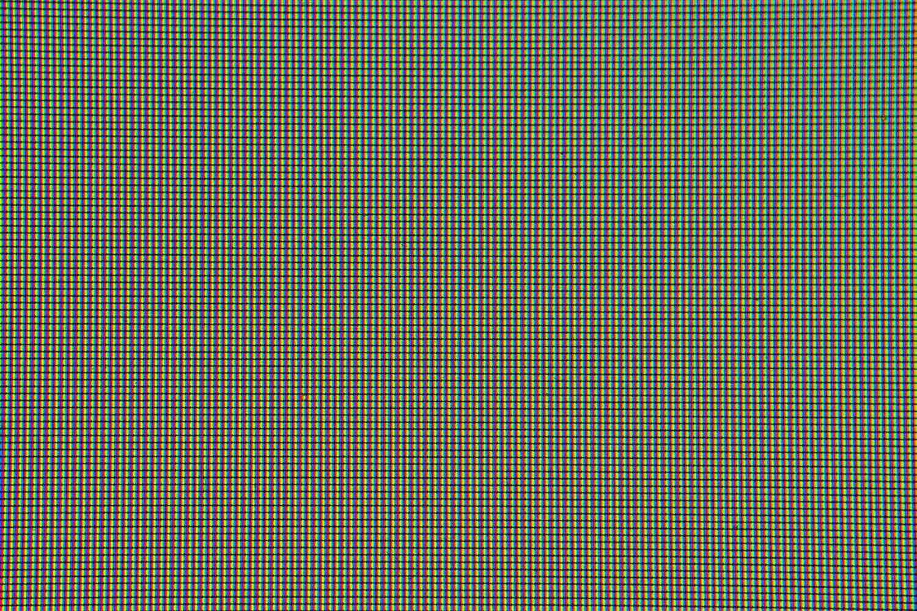
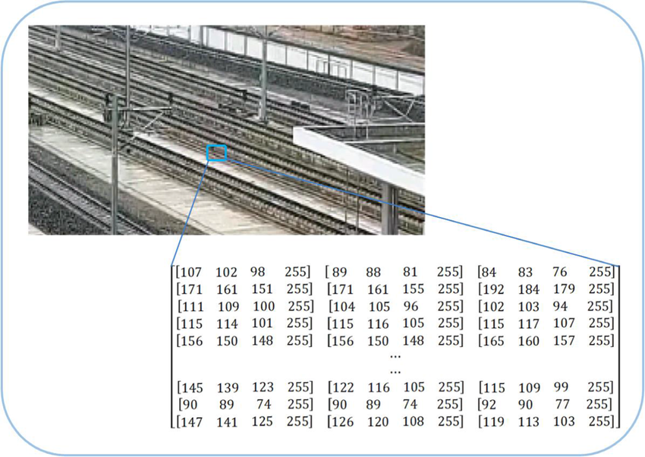
Imaging Basics
A pixel: Smallest unit of a digital image
Resolution: Number of pixels in an image (width x height)
Color depth: Bits needed to represent each pixel(bpp)
1 bit: (0-1)
8-bit (0-255)
24-bit (RGB)
32-bit (RGBA, supports transparency)
Color spaces:
RGB
BGR
Grayscale
HSV(Bettering Human Perception)
Color type, Saturation, Value (Brightness)
Most computers store images as matrices
2D array for grayscale images
3D array for color images
Each element represents one pixel
Notes:
Samarth
Pixels combined with millions of others, forms the complete image
Higher resolutions mean more pixels, which generally result in finer image detail
1 Bit -> Each pixel is represented by 1 bit,allows for two colors -> black and white
8-bit -> Each pixel is represented by 8 bits, has 256 shades per color channel
24 bit -> three 8 bit channels Red, Blue, Green -> 16 million colors and used as the standard for high quality imaging
32 bit -> Another 8 bit channel called alpha channel which allows for transparency
Different colors spaces represent colors in different ways, RGB and BGR are common for images as grayscale uses shades of gray
HSV(Betters Human Perception of Image) - Hue (color type), Saturation, Value(brightness)

Slide 4
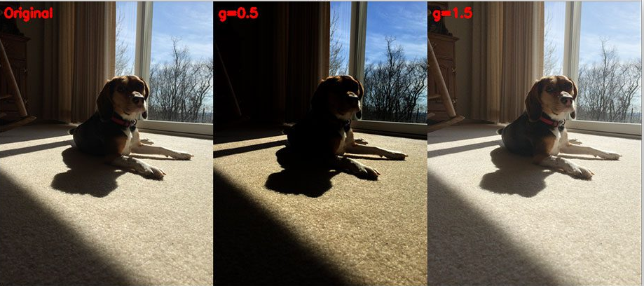
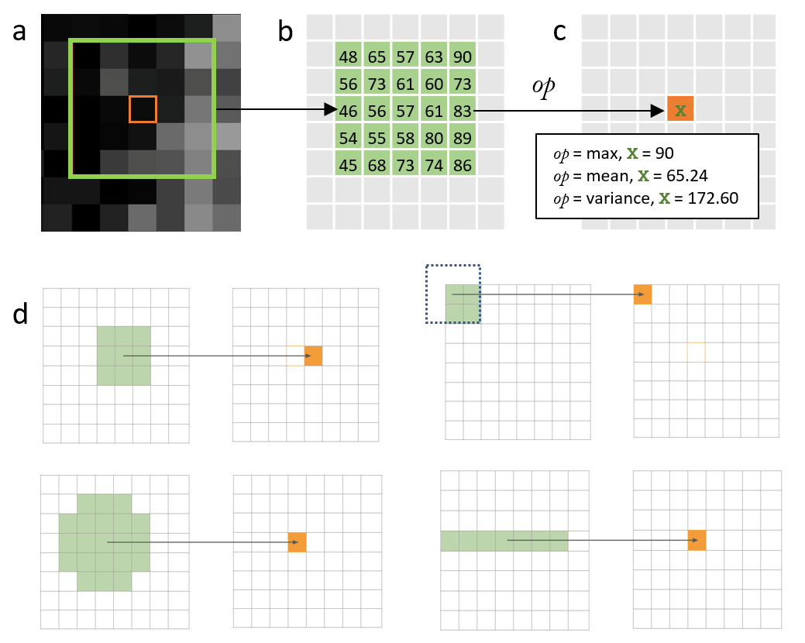
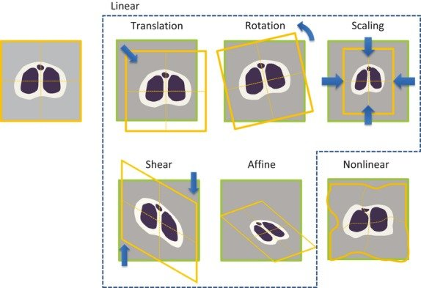
Basic Image Processing
Point Operations
Brightness adjustment (+ or - value)
Contrast enhancement (multiplication)
Thresholding (binary conversion)
Gamma correction (power law)
Geometric Transformations
Scaling (resize)
Rotation (angle)
Translation (move)
Flipping (mirror)
Affine transformations
Neighborhood Operations
Smoothing (blur)
Sharpening
Edge detection
Noise reduction
Median filtering
Notes:
Eric
Operations can be applied to entire image or regions (ROI: regions of interest)
Most operations support different image types (8-bit, float)
Processing can be done in different color spaces
There’s different packages to read in images (cv2 and PIL), and they are different in reading color channels of the image (cv2: BGR, PIL:RGB)
Why do we need image processing?
they help prepare, enhance, and transform images, enabling computer vision models to work with more relevant and consistent data
Normalize and enhance images, making key features stand out.
Prepare images for analysis by standardizing size, orientation, and lighting.
Improve model robustness by making the model less sensitive to variations in position, size, noise, and lighting.
Generalize to more complex patterns and avoid overfitting

Slide 5





What we will be using today
Google Colab: For sharing code
Python: Programming language commonly used for machine learning
OpenCV: Library that provides functions for real-time and offline computer vision
PyTorch: Deep learning library used for constructing neural networks
Torchvision: PyTorch extension containing functions for image transformations and augmentations
Matplotlib: For visualizing our data
Notes:
Eric

Slide 6

Notebook With Exercises
https://tinyurl.com/uclacvdatateach
Notes:
Eric

Slide 7
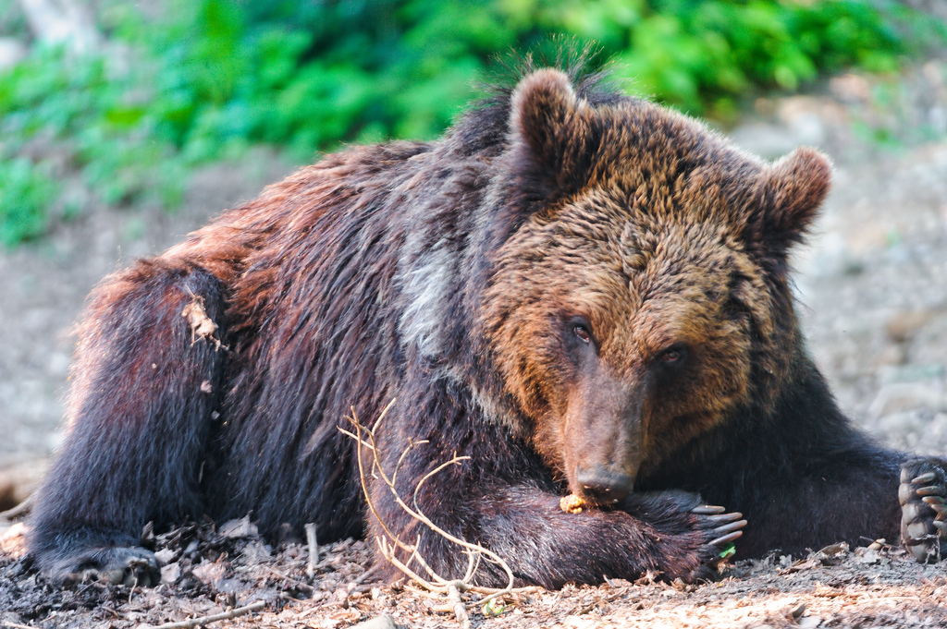
Exercise 1: Loading and basic image processing
Since most image operations happen on a matrix representation of the image, our first step is to “read” the image as matrix
We can do this with cv2.imread(“/path/to/image”)
For efficiency, OpenCV converts an image to a Numpy array, which is more efficient than a Python list
You can get the data type of a Numpy array with .dtype
You can get the max and min with .max() and .min() respectively
Since color images are represented by their red, green, and blue components, we can break apart images and “stitch” them back together

Slide 8
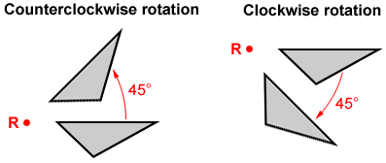
Exercise 2: Basic Image Operations
Resizing
Involves scaling the dimensions of an image
It preserves the original proportions
Cropping
Extracts a specific portion of the image
Removes unwanted outer areas
Helps focus on the main subject
Rotation
Turns the image around its center point
Can be done in degrees (90°, 180°, 270°)
May require padding or cropping to handle corners
Flipping
Mirrors the image horizontally or vertically
Useful for data augmentation
Helps models learn orientation invariance
cv2.resize(image, (new_width, new_height), interpolation)
Takes in three parameters: image to resize, (width, height), interpolation

Slide 9
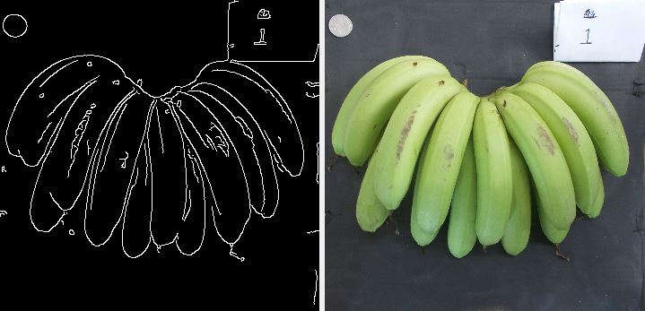
Exercise 3: Landmark Detection
Gaussian Blur
Reduces image noise and detail
Uses a Gaussian kernel (bell-shaped) to “smooth” out an image
Parameters:
Size of the kernel
Kernel intensity
Essentially preprocessing
Contour Drawing
Finds areas of intensity in the image
Find contours (cv2.findContours)
Draw contours (cv2.drawContours)
Applications
Object counting
Shape detection
Feature extraction
Background Subtraction
Thresholding (cv2.threshold)
Creates a binary mask and applies it to the image
Used for: isolating objects, removing unwanted objects, preparing images for contour drawing

Slide 10
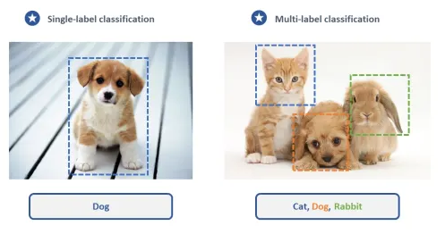
Machine Learning in Computer Vision
Machine Learning: Process of teaching computers to learn from data without explicit programming
System learns patterns and features from examples instead of following rules
Very useful for images, where data is often unstructured and is difficult to consider all scenarios
ML can
Handle variations in lighting, pose, scale
Learn relevant features automatically
Generalize to new, unseen examples
Adapt to different conditions
Types of Training data
Labeled images for supervised learning
Unlabeled images for unsupervised learning
Use cases
Classification tasks (object recognition)
Detection tasks (bounding boxes)
Segmentation tasks (pixel-level labels)
Can require significant human annotation effort
Notes:
Eric
In computer vision, machine learning is especially useful. Images are complex and unstructured, meaning they don’t have neat, organized patterns. Instead, they’re filled with all sorts of variations in lighting, angle, and even quality, which makes them challenging to interpret. Machine learning helps by allowing computers to learn from many examples and recognize patterns that would be hard to explain in simple rules.
Supervised vs. Unsupervised
Supervised: learned the direct relationship between labels and outcomes (classification and regression)
Unsupervised: learned hidden structures within data (clustering)
Use cases:
Segmentation: For instance, in a medical image, segmentation might be used to label every pixel that is part of a tumor, helping doctors identify its exact shape and size.

Slide 11
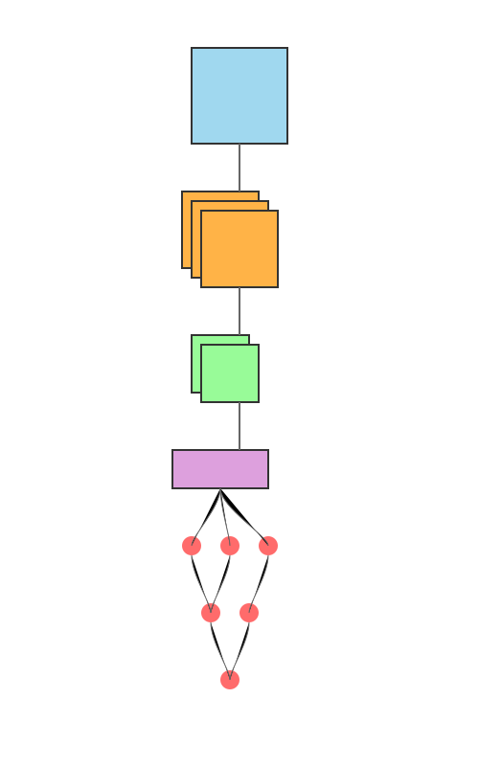
Deep Learning in Computer Vision
Deep Learning: subset of machine learning focused on neural nets
Key components:
Neurons (nodes)
Layers
Weights and biases
Activation functions (ReLU, sigmoid, tanh)
Loss functions
Optimizers (SGD, Adam, RMSprop)
Convolutional Neural Network (CNN)
A convolutional neural network is specifically designed to process grid-like data (i.e. images)
Layers:
Convolutional Layers: extract features from images
Activation Function: adds non-linearity to our network
Pooling Layers: reduces spatial dimensions
Fully Connected Layers: final classification/regression
Notes:
Atharv
Operations can be applied to entire image or regions (ROI)
Most operations support different image types (8-bit, float)
Processing can be done in different color spaces

Slide 12
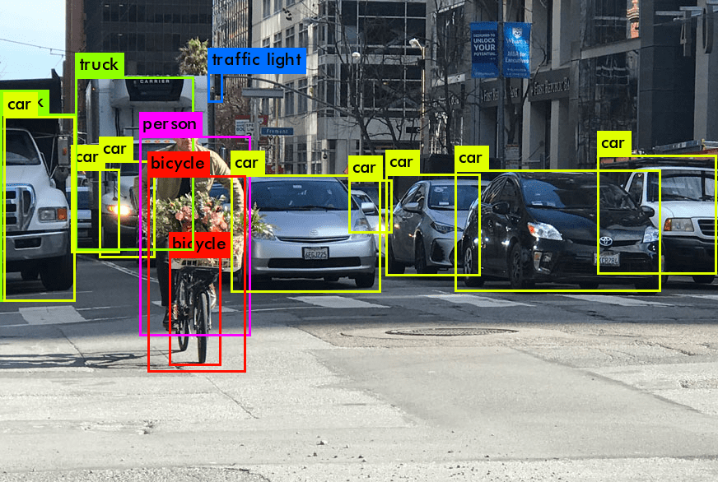
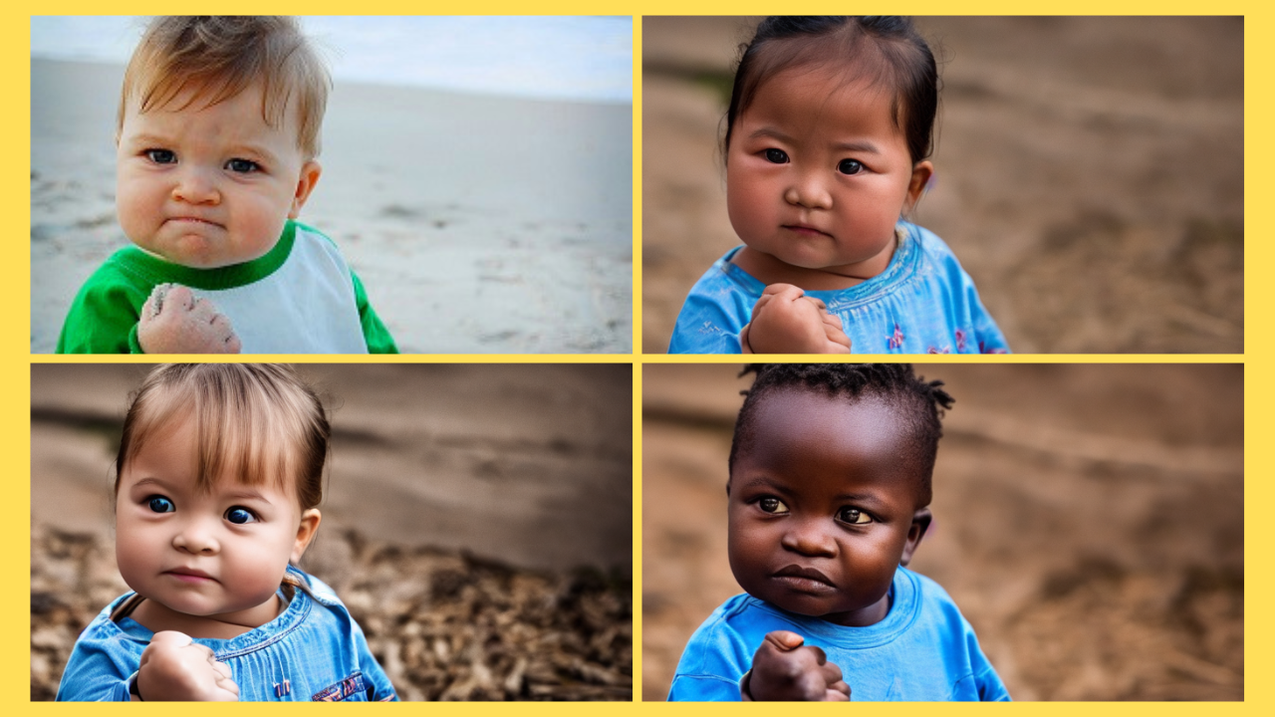
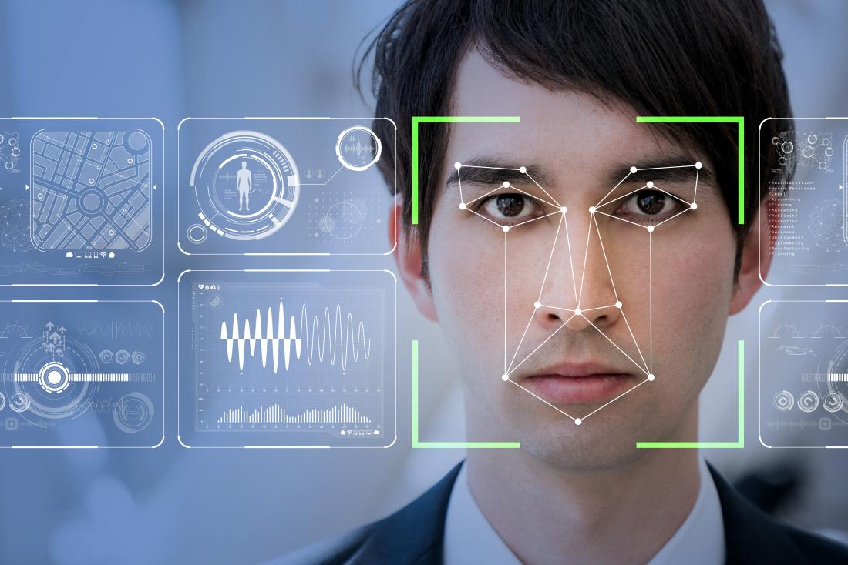
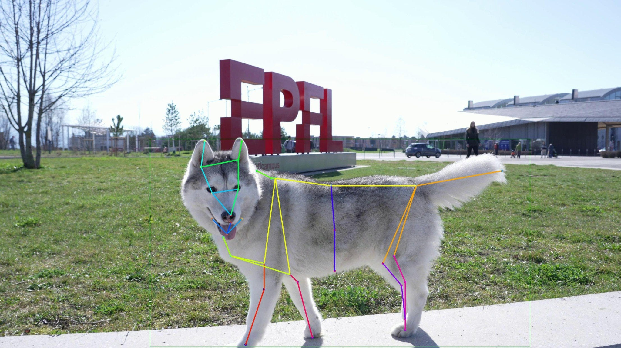
Deep Learning in Computer Vision
Deep Learning can have some very cool applications in computer vision
Image Classification
Identifying objects, photos, or categories in images
Object Detection
Locating and identifying multiple objects in a single image
Face Recognition
Identifying and verifying individuals from facial features
Image Generation
Creating new images from descriptions or other images
Pose Estimation
Detecting human body positions and movements
Style Transfer
Applying artistic styles to regular photographs
Notes:
Atharv
Operations can be applied to entire image or regions (ROI)
Most operations support different image types (8-bit, float)
Processing can be done in different color spaces

Slide 13
Today, we will be creating a style transfer model that applies a cartoon artistic style!
Notes:
Samarth

Slide 14
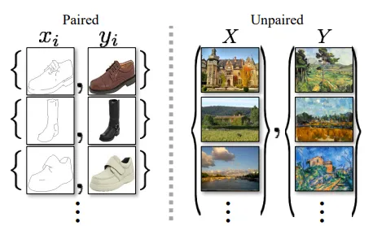
We will be creating a model for style transfer!
Generative Adversarial Network: A deep learning model used often for image generation
A GAN has two components: a Generator and a Discriminator
The Generator learns to generate images (in this case, transform images to a cartoon style) and the Discriminator tries to “guess” whether the generated images are real or fake
We will be implementing CartoonGAN – a GAN specifically optimized for cartoons!
Instead of just predicting between fake and real images, CartoonGAN tries to predict against a smoothed version of the cartoon images, which makes it generate better images
CartoonGAN works on unpaired images - images that do not correspond to one another
Notes:
Atharv

Slide 15
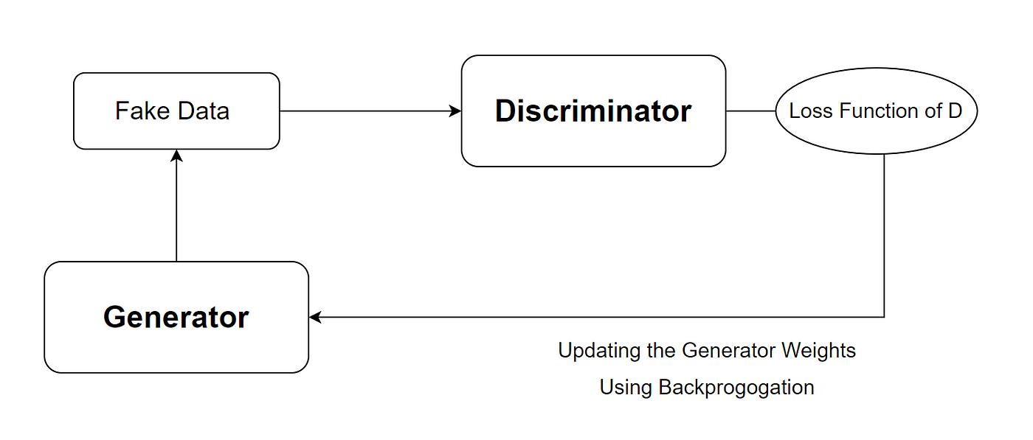
Model Training
Step 1: Train Discriminator
Shows D three types of images:
Real cartoons (should say "real")
Smoothed cartoons (should say "fake")
Generated images (should say "fake")
Like training an art critic to spot different styles
Step 2: Train Generator
G tries to create images that:
Look like cartoons (fool D)
Preserve original photo content
Like an artist learning to balance style and content
Validation & Checkpointing
Regularly tests G's performance on new photos
Saves the best performing model
Like keeping your best artwork for reference

Slide 16
Model Inference
At the end, our trained Generator can be used for generating realistic cartoon images!
We will use our Generator specifically to convert images to cartoons

